Slide 1
C Programming
Function Pointer & Hash Tables
Week 2

Slide 2
Overview
Pointers
Void pointers
Function pointers
HashTables

Slide 3
Void pointers
C does not allow us to declare and use void variables.
void can be used only as return type or parameter of a function.
C allows void pointers
Question: What are some scenarios where you want to pass void pointers?
void pointers can be used to point to any data type
int x; void∗ p=&x; /∗ points to int ∗ /
ﬂoat f ; void∗ p=&f; /∗ points to ﬂoat ∗ /
void pointers cannot be dereferenced. The pointers should always be cast before dereferencing.
void∗ p; printf ("%d",∗p); /∗ invalid ∗/
void∗ p;
int * px = (int * ) p;
printf(“ %d ”, *px)

Slide 4
Function Pointers

Slide 5
Types
Following this line of thought:
A type is a set of values equipped with a set of operations on those values
A function is a computation abstracted over the types defined by its inputs
Hence, a function is an abstraction: it represents the set of values produced by its computation when instantiated with specific arguments.
Hence, functions should be allowed to be abstracted over functions, just as they are abstracted over primitives & structures

Slide 6
Concretely...
C permits functions to be treated like any other data object
A function pointer can be supplied as an argument
Returned as a result
Stored in any array
Compared
Main caveat:
Cannot deference the object pointed to by a function pointer on the left- hand side of an assignment

Slide 7
Function pointers
In some programming languages, functions are ﬁrst class variables (can be passed to functions, returned from functions etc.).
In C, function itself is not a variable. But it is possible to declare pointer to functions.
Question: What are some scenarios where you want to pass pointers to functions?
Declaration examples:
int (∗ fp )( int ) /∗ notice the () ∗ /
int (∗ fp )( void∗ ,void∗)
Function pointers can be assigned, pass to and from functions, placed in arrays etc.

Slide 8
Function Pointer Example
#include <stdio.h>
int x10(int n);
int x2(int n);
void mutate_map(int A[], int n, int(*fp)(int));
void print_array(int A[], int n);
int x2 (int n) { return 2*n; }
int x10(int n) { return 10*n; }
void mutate_map(int A[], int n, int(*fp)(int)) {
for (int i = 0; i < n; i++)
A[i] = (*fp)(A[i]);
}
void print_array(int A[], int n) {
for (int i = 0; i < n; i++)
printf("%d ",A[i]);
printf("\n");
}
% ./map
3 1 4
6 2 8
60 20 80
int main(void)
{
int A[] = {3,1,4}, n = 3;
print_array(A, n);
mutate_map (A, n, &x2);
print_array(A, n);
mutate_map (A, n, &x10);
print_array(A, n);
}
OR
typedef int(*p1)(int);
P1 ptr1= x10;
mutate_map (A, n, ptr1);
Notes:
map (actually mutate_map easier)

Slide 9
Calling functions
Example: Consider the case where different functions are called based on a value.
enum TYPE{SQUARE, RECT, CIRCLE ,POLYGON} ;
struct shape {
f l o a t params [MAX] ;
enum TYPE type ;
} ;
void draw ( struct shape∗ ps )
{
switch ( ps−>type )
{
case SQUARE:
draw_square ( ps ) ; break ;
case RECT:
draw_rect ( ps ) ; break ;
. . .
}
}

Slide 10
Array of function pointers
The same can be done using an array of function pointers instead.
void ( ∗ fp [ 4 ] ) ( struct shape∗ ps ) =
{& draw_square ,& draw_rec ,& draw_circle ,& draw_poly } ;
OR
typedef void ( ∗ fp ) ( struct shape∗ ps );
fp f [ 4 ] =
{& draw_square ,& draw_rec ,& draw_circle ,& draw_poly } ;
void draw ( struct shape∗ ps )
{
} ( fp [ ps−>type ] ) ( ps ) ; / ∗ c a l l the c o r r e c t f u n c t i o n ∗ /

Slide 11
Hashing

Slide 12
Motivating Hash Tables
For a dictionary with n key, value pairs
insert find delete
Unsorted linked-list O(1) O(n) O(n)
Unsorted array O(1) O(n) O(n)
Sorted linked list O(n) O(n) O(n)
Sorted array O(n) O(log n) O(n)
Balanced tree O(log n) O(log n) O(log n)
Use key to compute array index for an item in O(1) time [doable]
Have a different index for every item [magic]
Notes:
balanced tree is almost there
infinite possibilities for key values, so hard to have a different index for each to map to

Slide 13
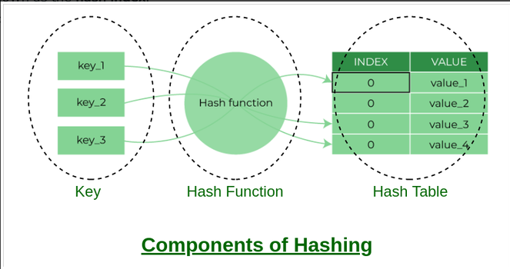
Hash Tables

Slide 14
Hash Tables
Aim for constant-time (i.e., O(1)) find, insert, and delete
“On average” under some often-reasonable assumptions
A hash table is an array of some fixed size
Basic idea:
hash table
0
 | …
hash function:
index = h(key)
TableSize –1
key space (e.g., integers, strings)

Slide 15
Hash table
Hash tables (hashmaps) combine linked list and arrays to provide an efﬁcient data structure for storing dynamic data. Hash tables are commonly implemented as an array of linked lists (hash tables with chaining).
keys
buckets
entries
000
Lisa Smith
521-8976
John Smith
001
002
Lisa Smith
: :
John Smith
521-1234
151
152
153
154
Sam Doe
Sandra Dee
521-9655
Sandra Dee
: :
Ted Baker
418-4165
Ted Baker
253
254
255
Sam Doe
521-5030
Figure: Example of a hash table with chaining

Slide 16
Hash table
Each data item is associated with a key that determines its location.
Hash functions are used to generate an evenly distributed hash value.
A hash collision is said to occur when two items have the same hash value.
Items with the same hash keys are chained
Retrieving an item is O(1) operation.

Slide 17
Hash Tables
There are m possible keys (m typically large, even infinite)
We expect our table to have only n items
n is much less than m (often written n << m)
Many dictionaries have this property
Compiler: All possible identifiers allowed by the language vs. those used in some file of one program
Database: All possible student names vs. students enrolled
AI: All possible chess-board configurations vs. those considered by the current player
…

Slide 18
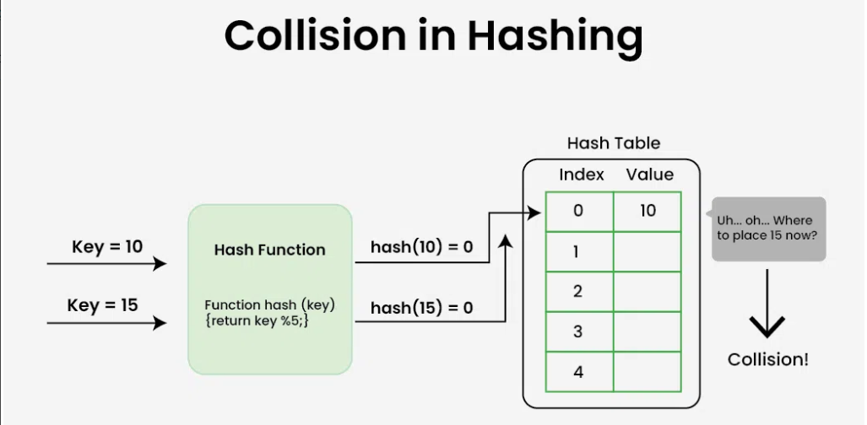
Collision in hash tables

Slide 19
Hash tables
Hash functions:
A hash function maps its input into a ﬁnite range: hash value, hash code.
Other uses of hash functions: cryptography, caches (computers/internet) etc.
Hash function types:
Division type
Multiplication type
Other ways to avoid collision: linear probing, double hashing.

Slide 20
Hash table: example
# define MAX_BUCKETS 1000
# define MULTIPLIER 31
struct wordrec
{
char ∗ word ;
unsigned long count ;
struct wordrec ∗ next ;
} ;
/ ∗ hash bucket ∗ /
struct wordrec ∗ t a b l e [ MAX_LEN ] ;

Slide 21
Hash table: example
unsigned long h a s h s t r i n g ( const
{
unsigned long hash = 0 ;
char ∗
s t r )
while ( ∗ s t r )
{
hash= hash∗MULTIPLIER+∗ s t r ; s t r ++;
}
return hash % MAX_BUCKETS ;
}

Slide 22
Hash table: example
struct wordrec ∗ lookup ( const char ∗ s t r , i n t
create )
{
struct wordrec ∗ c u r r =NULL ;
unsigned long hash= h a s h s t r i n g ( s t r ) ;
struct wordrec ∗ wp= t a b l e [ hash ] ;
for ( c u r r =wp ; c u r r ! =NULL ; c u r r =curr −>next )
/* If not found*/
i f ( create )
/ ∗ add to f r o n t ∗ /
return c u r r ;
}

Slide 23
Who hashes what?
Hash tables can be generic
To store elements of type E, we just need E to be:
Hashable: convert any E to an int
Comparable: order any two E (only when dictionary)
When hash tables are a reusable library, the division of responsibility generally breaks down into two roles:
client
hash table library
collision?
collision
resolution
E
int
table-index
We will learn both roles, but most programmers “in the real world” spend more time as clients while understanding the library

Slide 24
More on roles
Some ambiguity in terminology on which parts are “hashing”
client
hash table library
collision?
collision
resolution
E
int
table-index
“hashing”?
“hashing”?
Two roles must both contribute to minimizing collisions (heuristically)
Client should aim for different ints for expected items
Avoid “wasting” any part of E or the 32 bits of the int
Library should aim for putting “similar” ints in different indices

